Slide 1
Business Process Engineering
Week 12

Slide 2
Process Models
Edge: Directed edges are used to express the relationships between nodes in a process model.
Node: A node in a process model can represent an activity model, an event model, or a gateway model.
Activity Models: Activity models describe units of work conducted in a business process. Each activity model has exactly one incoming edge and exactly one outgoing edge.
Event models: Event models capture the occurrence of states relevant for a business process. Process instances start and end with events, so process models start and end with event models.
Gateway Models: Gateways are used to express control ﬂow constructs, including sequences, as well as split and join nodes.

Slide 3
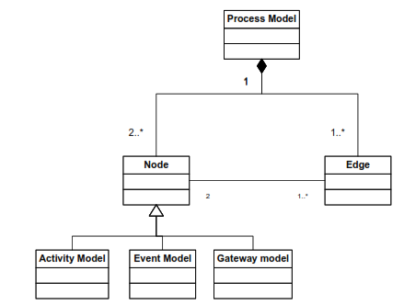

Slide 4
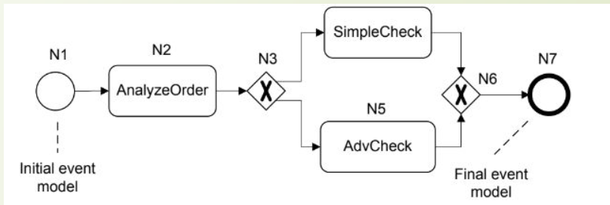
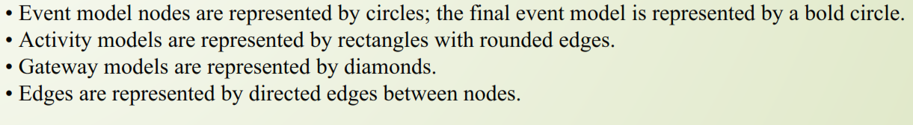

Slide 5
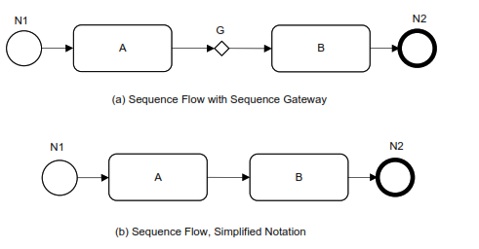
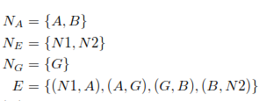
Let C be a set of control ﬂow constructs.
P = (N, E, type) is a process model if it consists of a set N of nodes, and a set E of edges.
• N = NA ∪ NE ∪ NG, where NA is a set of activity models, NE is a set of event models, and NG is a set of gateway models. These sets are mutually disjoint.

Slide 6
Gateways
Gateways are used to control how the Process flows through Sequence Flows as they converge and diverge within a Process.
Route a sequence flow following a decision,
using an exclusive or inclusive gateway; or alternatively
Undertake activities in parallel, using the parallel gateway.
Gateways are shaped like the Decision Diamonds

Slide 7
there are only a 6 types of Gateways:
Exclusive Gateways;
Inclusive Gateways;
Parallel Gateways;
Event Based Gateways;
Parallel Event Based Gateways; and
Complex Gateways.

Slide 8

Exclusive Gateway
The Exclusive Gateway is used to create alternative paths within a Process flow.
It is the “diversion point in the road” for a Process.
The Exclusive Gateway represents the need to make a decision where only one of the paths can be taken

Slide 9

Inclusive Gateway
The Inclusive Gateway is used to create both alternative and parallel paths within a Process flow.
The Inclusive Gateway represents the need to make a decision where all conditions must be evaluated.
Whilst the Inclusive Gateway can be used to show that all paths must be taken, it should be used in such a way that at least one of the paths is taken.

Slide 10
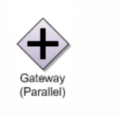
Parallel Gateway
The Parallel Gateway is used to represent parallel paths in a process.
The Parallel Gateway does not check any conditions and
Will wait for all incoming flows before triggering the parallel path.

Slide 11

Event Based Gateway
The Event-Based Gateway represents a branching point in the Process where the alternative paths that follow the Gateway are based on Events that occur rather than the evaluation of the process flow that lead to this point.
A specific Event such as the receipt of a message from a customer, determines the path that will be taken.

Slide 12

Complex Gateways
The Complex Gateway is used to represent complex synchronisation behaviour in a process.
A complex gateway is used when one or more of the outgoing sequence flows from the decision may be taken.
The Complex Gateway must have a default path.

Slide 13

Parallel Start Gateway

Slide 14
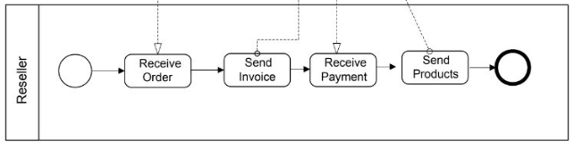
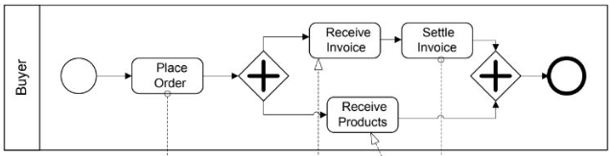
Example

Slide 15
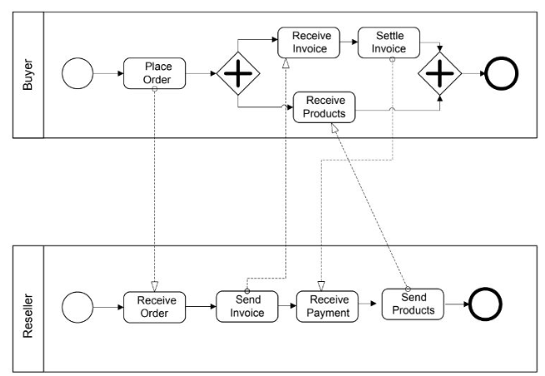
Process Interactions

Slide 16
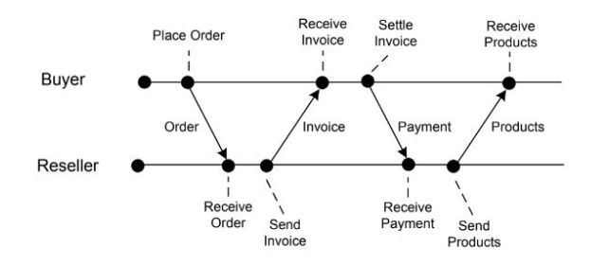
Event Diagram

Slide 17
Modelling Process Data
Business processes operate on data.
Explicitly representing data, data types, and data dependencies between activities of a business process puts a business process management system in a position to control the transfer of relevant data as generated and processed during processes enactment.
Data modelling is at the core of database design.
The Entity Relationship approach is used to classify and organize data in a given application domain.

Slide 18
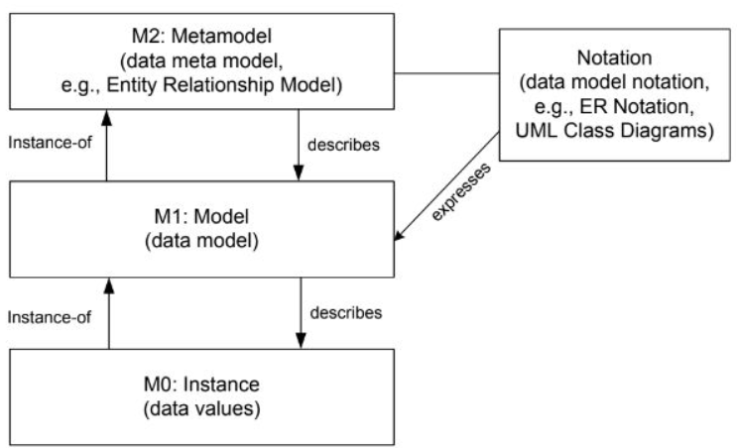
Metamodel for Data

Slide 19
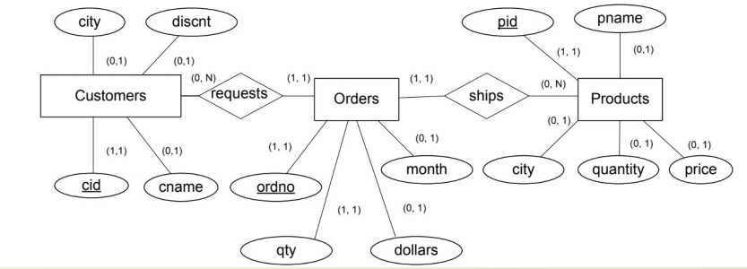
Modelling Process Data

Slide 20

To organize data-related issues in business process management, workflow data patterns have been introduced.
Purpose: how to handle data in business processes.
They are organized according to the dimensions:
Data visibility
Data interaction
Data transfer
Data-based routing.

Slide 21
Data Visibility
The most important workflow data patterns regarding data visibility are as follows.
1. Task data: The data object is local to a particular activity; it is not visible to other activities of the same process or other processes.
2. Block data: The data object is visible to all activities of a given subprocess.
3. Workflow data: The data object is visible to all activities of a given business process, but access is restricted by the business process management system, as defined in the business process model.
4. Environment data: Data elements which exist in the external operating environment are able to be accessed by components of processes during execution.

Slide 22
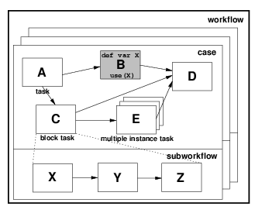
Data Visibility
5. Scope Data
6. Multiple Instance Data
7. Case Data
8. Folder Data

Slide 23
Data Interaction
The various ways in which data elements can be passed between components in a process and how the characteristics of the individual components can influence the manner in which the trafficking of data elements occurs.
Of particular interest is the distinction between the communication of data between components within a process as against the data-oriented interaction of a process element with the external environment.

Slide 24
Data Interaction
Data Interaction - Task to Environment - Push-Oriented
Data Interaction - Environment to Task - Pull-Oriented
Data Interaction - Environment to Task - Push-Oriented
Data Interaction - Task to Environment - Pull-Oriented
Data Interaction - Case to Environment - Push-Oriented
Data Interaction - Environment to Case - Pull-Oriented
Data Interaction - Environment to Case - Push-Oriented
Data Interaction - Case to Environment - Pull-Oriented
Data Interaction - Workflow to Environment - Push-Oriented
Data Interaction - Environment to Workflow - Pull-Oriented
Data Interaction - Environment to Workflow - Push-Oriented
Data Interaction - Workflow to Environment - Pull-Oriented

Slide 25
Data Transfer
Here we consider the manner in which the actual transfer of data elements occurs between one process component and another.
Data Transfer by Value - Incoming
Data Transfer by Value - Outgoing
Data Transfer - Copy In/Copy Out
Data Transfer by Reference - Unlocked
Data Transfer by Reference - With Lock

Slide 26
Data-based Routing
The various ways in which data elements can interact with other perspectives and influence the overall operation of a process instance.
Task Precondition - Data Existence
Task Precondition - Data Value
Task Postcondition - Data Existence
Task Postcondition - Data Value

